Slide 1
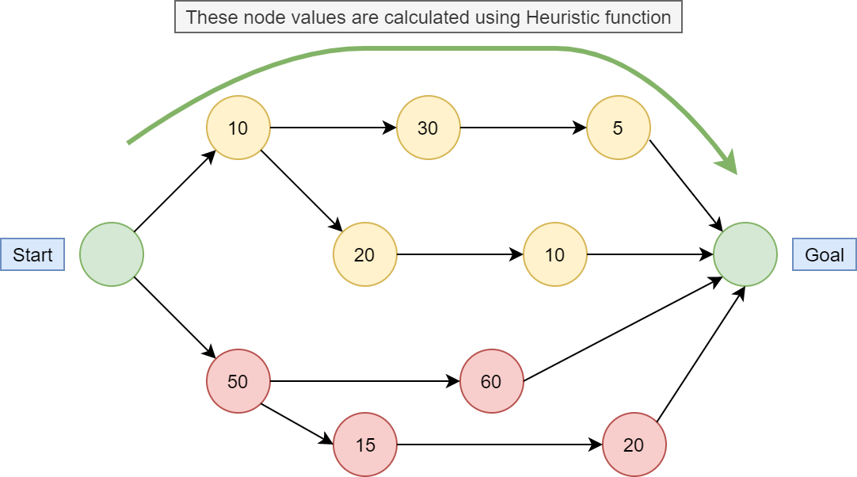
Search •A lot of AI boils down to search—searching through:
states
assignments of values
orderings of a route
•Uninformed or unsupervised search does not require of any knowledge of the problem domain.
It is a brute-force approach.
•Terminology: •We begin in some starting state, searching for a goal state. •We have some method of transitioning from the current state to 1 or more successor states. •Unsupervised search offers no method of selecting one transition over another for a given state.
There's no fixed metric to tell us if we’re getting closer to the goal until we’re there. •One partial solution:
Use some measurement (derived from purely local information) to make a selection from offered successor states.
Search methods which use this solution are said to employ a greedy algorithm

Slide 2
Evaluating Search Methods •We obviously need some way of determining whether we’re at the goal state
•The path length between two states is the number of transitions necessary to move between them.
•If each transition has its own independent cost that may differ from 1, the path cost is the sum of all transitions on the path
•Note that in this case the lowest cost path to the goal may not be the shortest (lowest number of transitions)
•Depending on the problem, state transitions may –or– may not be reversible
•We can produce a state-space graph showing the possible transitions.
•The maximum or average number of transitions existing out of a particular state is the branching factor
•If we select only transitions that avoid cycles, a search tree results

Slide 3
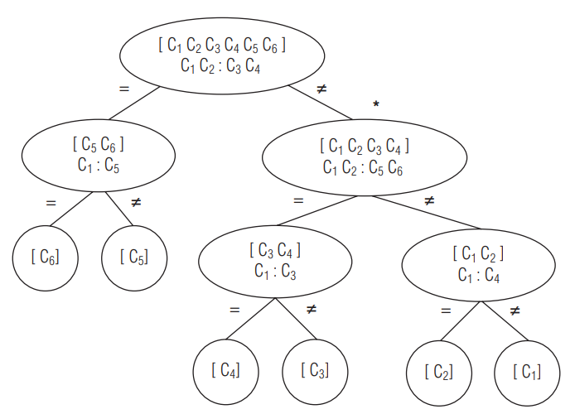
False Coin Problem •Each state is a node (the list of which coin might be false,
and what should be done at each), and the path chosen on
the result of each comparison.
•As every possible outcome is accounted for, and each
path terminates with exactly 1 solution, this is a
map of the search space that must be dealt with.
•The total state-space map of a problem contains every state the
problem might be in, and all transitions between
states; obviously it can become quite complex
•Sometimes we want to find out if any path from a
start state exists to any solution; other times
we want to find a shortest or lowest-cost or in
some way optimal path
•Note that it may be convenient to represent
a state space graph as having more than 1 node for a specific state; see fig. 2.2, p. 48
•A sample search tree showing a solution
to the 6-coin False Coin problem is on p. 47.

Slide 4
•One method of finding a solution (in cases where we just want to know if any solutions exist) is to just generate all possible states, testing each to see if it’s a goal.
Move Solver •One example is the N-queens problem
•In chess, the queen can move horizontally along rows, vertically along files, or along either diagonal, and attacks every square it can move to. •The N-queens problem is: On an NxN board, place N queens such that no queen is attacking any other.
•We could just generate every permutation of N queens on an NxN board and pick out the solution(s) •For N = 10 (so a 10x10 board), there are 100 ways to place the first queen, 99 ways to place the second, etc., so total placements , or in general (n²/n) •We can reduce the size of this by observing, for example, that each row can contain only 1 queen, so begin by placing 1 queen in each row and only move queens along rows •Terminology: •An algorithm is correct if it can find a valid solution. •It is complete if it can find every solution; either every solution that exists, or every solution reachable from a given start state. •It is optimal if it finds the best (lowest-cost, nearest, whatever) solution. •It is optimally efficient if it finds the solution at least as fast as any other algorithm (in big-O form). •It is nonredundant if any state rejected as a possible solution is not proposed again. •It is informed if it is able to limit its proposals in some way rather than blindly generating every possible state (for example, every possible placement of N queens on the board)

Slide 5
Strategies
•Exhaustive enumeration consists of generating all possibilities
•But this can lead to wasted effort
•If the first 2 queens we place are attacking each other, there’s no point in placing the other N-2.
•While generating a state, we should verify that the partially-constructed solution satisfies all constraints
•If not, we try another; if no further progress can be made, we must backtrack, undoing part of what we have done so far, and making another attempt; if none can be found from there, we backtrack another step, and so on.
•Backtracking to solve 4-Queens, p 50-52

